Slide 1
From the US 9/11 attacks to the Japanese 3/11 earthquake Takehiko Ito (Wako University) take@wako.ac.jp www.itotakehiko.com Division 11: Political Psychology Presidential Address http://www.icap2014.com/divisional-programs/div-11-political-psychology/53 11:00-12:00, Sunday, July 13, 2014 Room 212/213, The Palais des Congrès - Paris France 28th International Congress of Applied Psychology 8-13 July 2014

Slide 2
Part I: The US 9/11 attacks in 2001

Slide 3
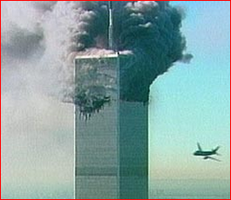
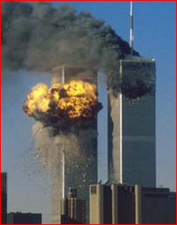
Quiz：How many building collapsed in WTC, NY on Sep. 11, 2001?

Slide 4
How many buildings of WTC collapsed, before the next day would come? The answer is …

Slide 5
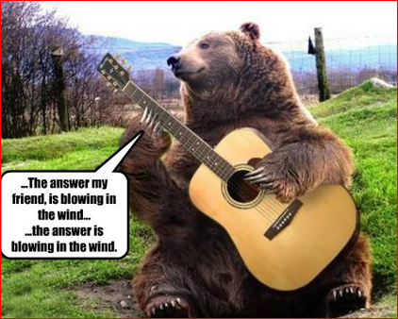
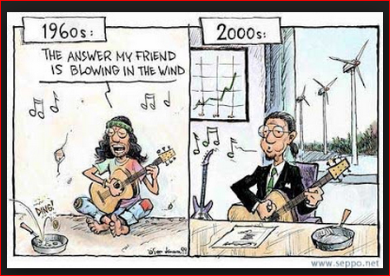
How many buildings of WTC collapsed, before the next day would come? The answer, my friend, is blowing in the wind? The answer is blowing in the wind??

Slide 6
The correct answer is three. Why?
＋ ？
WTC Buildings 1,2
Another WTC Building ？？？

Slide 7
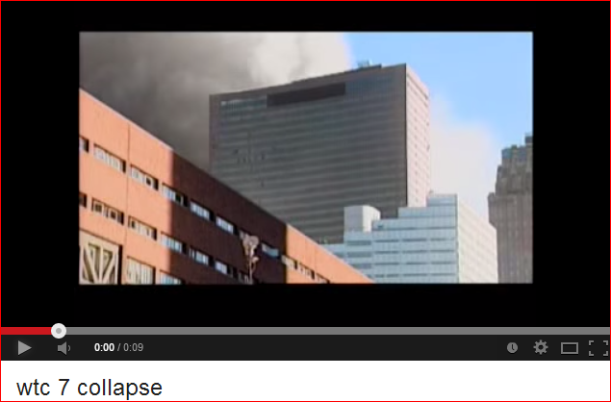
Because World Trade Center Building 7 collapsed at 5:20 pm on the same day https://www.youtube.com/watch?v=LD06SAf0p9A

Slide 8
What is WTC Building 7? http://rememberbuilding7.org/7-facts-about-building-7/
Building 7 was a 47-story skyscraper;
was part of the World Trade Center complex.
Built in 1984, it would have been the tallest high-rise in 33 states in the United States.
It collapsed at 5:20 pm on September 11, 2001.
It was not hit by an airplane;
and suffered minimal damage compared to other buildings much closer to the Twin Towers.

Slide 9
7 FACTS ABOUT BUILDING 7
1) If fire caused Building 7 to collapse, it would be the first ever fire-induced collapse of a steel-frame high-rise.
2) Its collapse was not mentioned in the 9/11 Commission Report.
3) In 2006, 43% of Americans did not know about Building 7.
4) It took the federal government seven years to conduct an investigation and issue a report for Building 7.
5) 1,700+ architects and engineers have signed a petition calling for a new investigation into the destruction of Building 7, including the possible use of explosives.
6) Numerous witnesses say the possibility of demolishing Building 7 was widely discussed by emergency personnel at the scene and advocated by the building’s owner.
7) housed by several intelligence and law enforcement agencies, and the NYC Office of Emergency Management’s Emergency Operations Center, more commonly known as “Giuliani’s Bunker”.

Slide 10
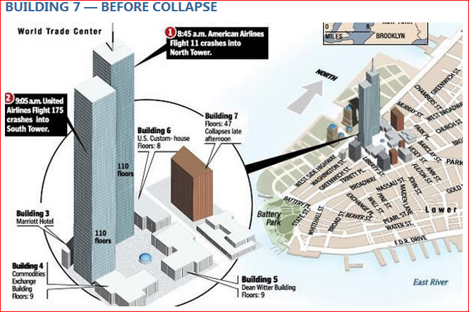
Where was WTC 7?

Slide 11
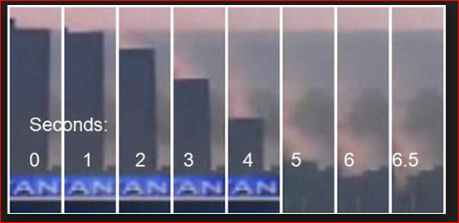
How WTC 7 collapsed =Free fall forming a parabola

Slide 12
World Trade Center 7: Some of the Tenants
the Internal Revenue Service Regional Council the United States Secret Service
New York City Office of Emergency Management
Department of Defense (DOD)
Central Intelligence Agency (CIA)
IRS.

Slide 13
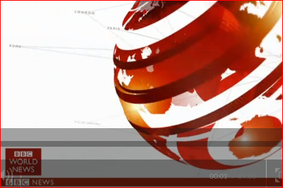
“the first and only steel skyscraper in the world to have collapsed due to fire” (BBC, ) (wikipedia)
Oh, BBC, what did you
broadcast on 9/11, 2001?

Slide 14
https://www.youtube.com/watch?v=ltP2t9nq9fI

Slide 16
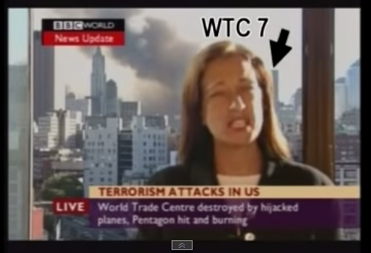

Slide 17
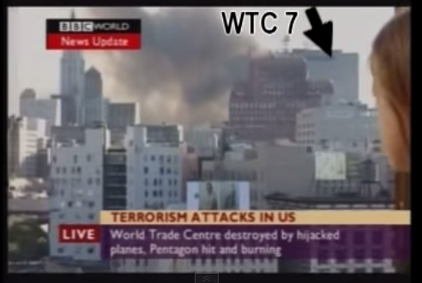

Slide 18
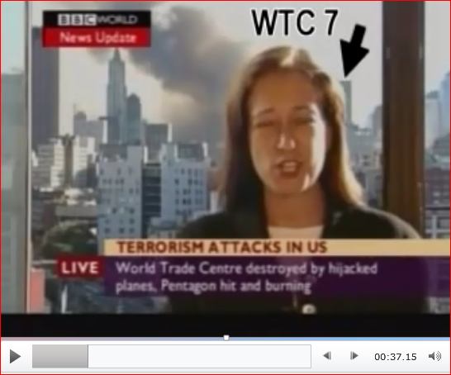

Slide 19
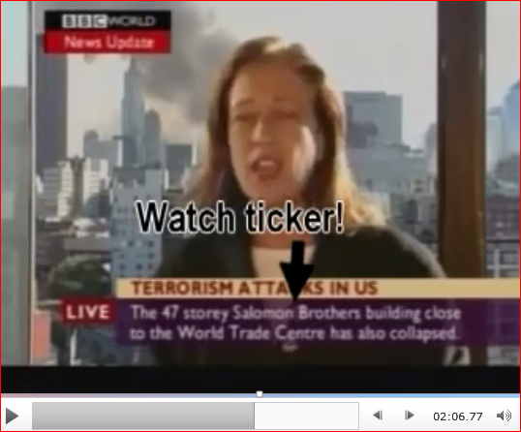

Slide 20
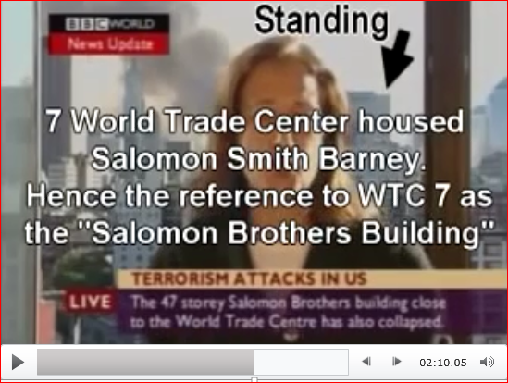

Slide 23
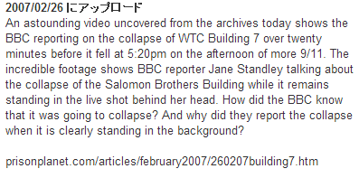
So why this “accident” happened?

Slide 24
Purpose：In 2010, after 10 years from the 9.11, how do we memorize the incident. This study examine the students attitude change between pre-test and post-test by watching a lecture DVD, 9/11:Blueprint for Truth （Japanese translation: β ver.： 58 minutes）, which claims that the collapse of WTC’ was caused by controlled demolition

Slide 26
Method
The participants were 45 students （male 30; female 15）. The experiment was done on December, 2009.
Pre-test:
Q1. How many buildings of New York WTC were collapsed on September 11, 2001?
Q2. How old were you at the time of incident?
Q3. Why those buildings were broken down?
Post-test:
Q1, Q3 above plus:
Q2. Have you ever seen this DVD before?
Q4. Write your impression or opinion after watching this DVD

Slide 27
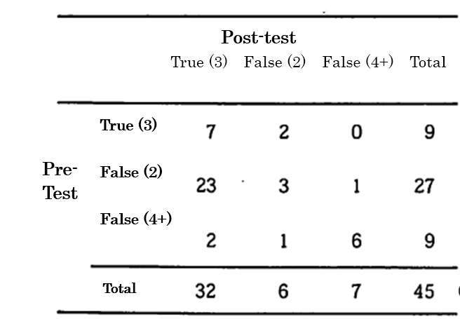
Table 1. Number of collapsed buildings

Slide 28
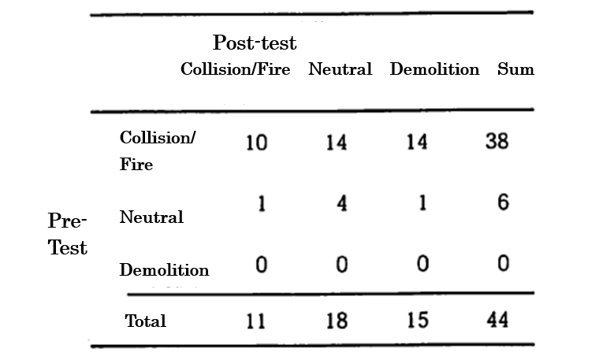
Table 2. Cause for collapse

Slide 29
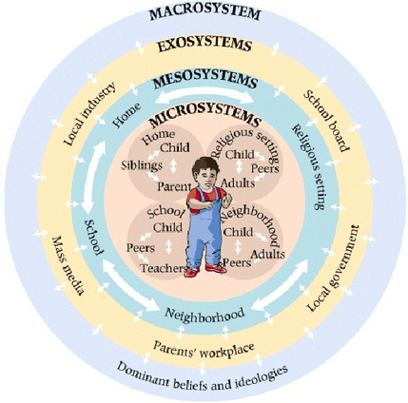
Results and Discussion
1) The third collapse of 7 WTC Building has been erased in our collective memory due to lack of information contact through the media.
2) We must pay attention to the discrepancy between shared memory and objective truth.
3) The lecture DVD was persuasive enough to develop our critical thinking.
4) Bronfenbrenner (1979) proposed ecology of human development by categorizing our environment into four levels: micor-, meso-, exo-, and macro-.
Macro-level media literacy development is important as well as micro-level media literacy education.

Slide 30
Part II: The Japanese 3/11 earthquake 2011

Slide 31
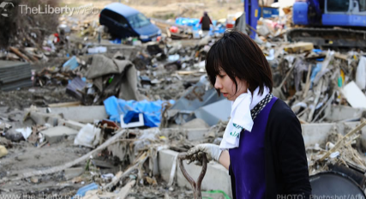
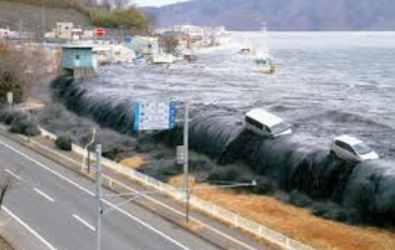
The Great East Japan Earthquake, which occurred on March 11, 2011, was a mega-earthquake
followed by a large tsunami.

Slide 32
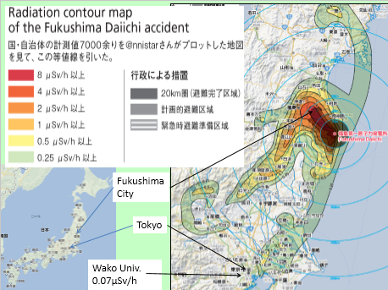
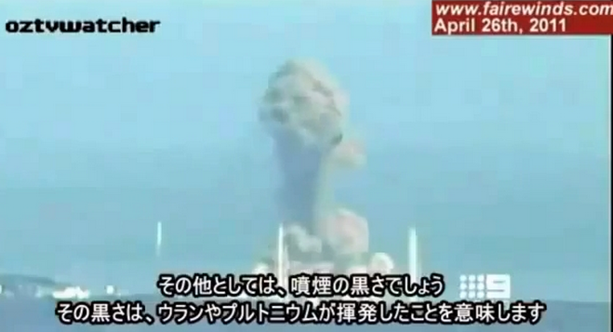
The disaster was compounded by meltdowns at the Fukushima Daiichi Nuclear Power Plant.
The disaster caused tremendous suffering in Japan, but it also shocked the entire world and drew global attention to the issue of widespread radiation leakage from the nuclear power plant.

Slide 33
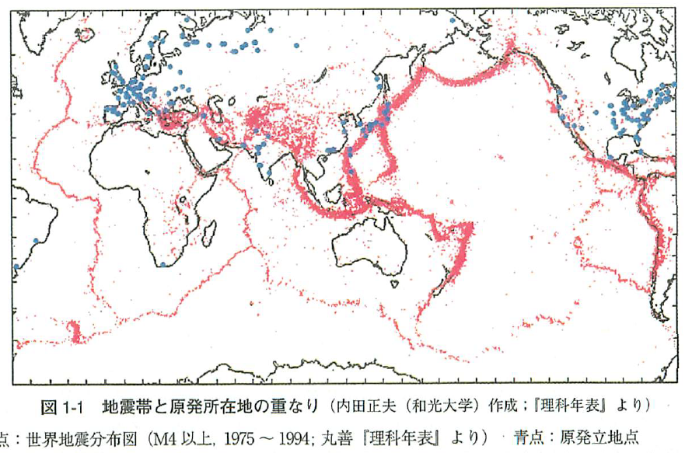
Earthquake ant nuclear power plant sites (It seems the accidents will happen again )

Slide 34
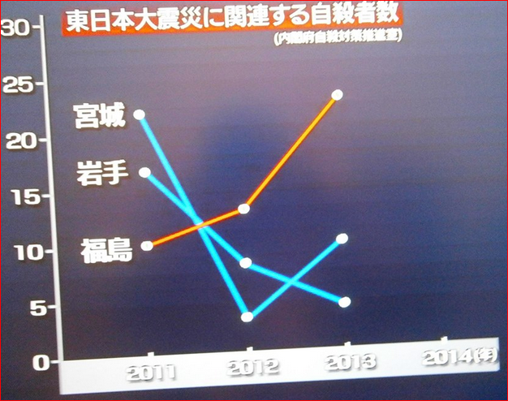
Fig. Number of suicide related to the earthquake according to prefectures
This leakage forced many people to evacuate their homes, and the large number of evacuees continues to represent a grave problem.
Due to the fact that the effects of radiation are long-lasting, the physical and emotional trauma that they caused will remain an important issue during the coming decades.
Fukushima
Miyagi
Iwate

Slide 35
Ito, T. 2014 Effects of tsunami and nuclear disaster on children’s time perspective: A text mining study of essays after the Great East Japan Earthquake Journal of International Society of Life Information Science, 32(1), 44-46.
Ito (2014) analyzed 161 essays written by school-aged children using the text mining technique;
and found that the victims of the nuclear plant accident in Fukushima are suffering more from their on-going relocation and limitations on outdoor play,
whilst the sufferers from the tsunami tend to describe their bitter experience as a past event and want to convey what they learned from it to the future.

Slide 36
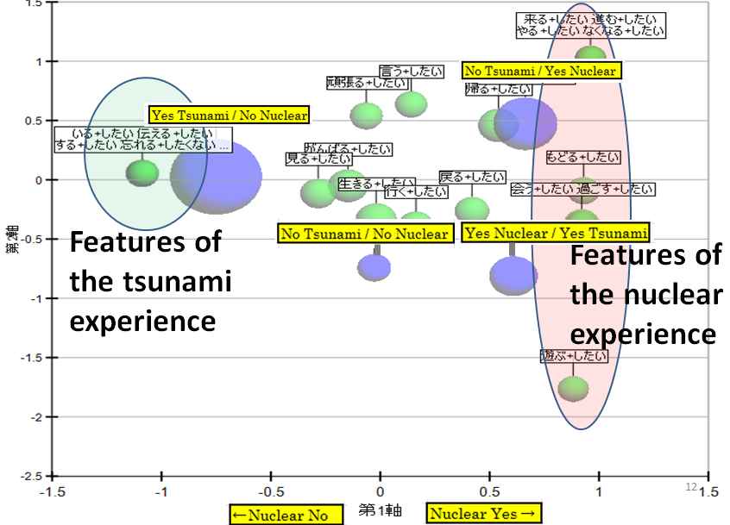
To proceed
To abolish
To say
To do best
To live
To get back
To meet
To live with
To remember
To tell people
What children want to do
To play outside
Notes:
We will now consider the results of the correspondence analysis of will/want expression in four groups according to their tsunami and nuclear experiences (Fig. 1). In this diagram of correspondence analysis the frequently used words in verbal expression of will and want in each of the four groups (tsunami only, earthquake only [= neither tsunami nor nuclear], nuclear only, both tsunami and nuclear) can be seen listed near the group location. Those children who had only the tsunami experience (left side in Fig. 1) mentioned the importance of conveying the experience such as “I don’t want to forget the tsunami disaster” and “I want to pass down the experience in the future.” Those children who were under the influence of the nuclear disaster (right side in Fig. 1), regardless of tsunami experience, often wrote about the inconvenience and pain in their life at that time, such as “I want to go back home,” “I want to see my friends,” “I want my home town to recover as before,” and “I want to play outside.” Those who had neither tsunami nor nuclear experience (i.e., earthquake experience only: center in Fig.1) often expressed their positive willingness such as “I will not give up,” “I will hold my own,” and “I want to live passionately.”
Discussion
The children’s lives have changed dramatically after the Great East Japan Earthquake. As the tsunami disaster occurs in the interval of once in decades or even hundreds of years, the children often focused on the importance to convey the experience for reduction of casualties for the next tsunami. Their time perspective was future-oriented based because the tsunami was now in the past. On the other hand, the experience of nuclear disaster was current and ongoing and therefore was quite different: those children often mentioned their present life as inconvenient and difficult, and about their painful feelings. The effects of the nuclear accidents were widespread not only geographically but also time consuming including the problems of housing relocation, disruption of school and workplace, food consumption, restrictions of play on the land, decontamination, money for reconstruction, etc. The nuclear accident has forcing children to endure long term distress in their daily life. Their time perspective was continuity from the disaster period, to the present time, and into the future.

Slide 37
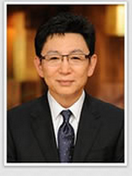
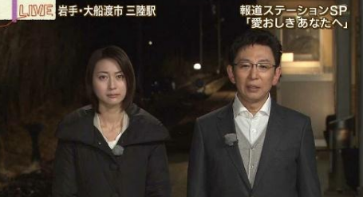
Ito, T. (in press) What kind of media contributes to human happiness?: From the news report on the 311 nuclear plant accidents
“We (Hodo Station) broadcasted a special program which featured an investigation of the Fukushima Daiichi Nuclear Power Plant accidents on December 28th last year. We investigated the doubt that the nuclear power plant had been already partially broken down because of the earthquake before the tsunami. Regrettably, we were not able to investigate the issue further this time. However, we recognize the existence of a village called ‘Nuclear Power Village.’
We will continue to investigate the issue on the nuclear plant in our program. Even if our program is terminated, I will never regret.”

Slide 38
2．Deleted video(and your memory)
The word, ‘Nuclear Power Village’ refers to the tight-knit community of legislators, regulators, local governments, scholars, and mass media. Furutachi’s comments can be watched on two websites.
The video of this broadcasting was uploaded in Miyatake’s blog, but was eventually deleted.
(“Ichiro Furutachi Hodo Station…
”This video was deleted because
TV-Asahi Corp. filed copyright
infringement.)

Slide 39
3．Background of pressure on broadcasting
Since March 11, 2011, we have shared three shocks: an earthquake, a tsunami, and the leakage of radioactive materials caused by the Fukushima Daiichi Nuclear Power Plant accident. This accident was caused by a breakdown of the main electronic supply, followed by the loss of the auxiliary power supply, which was a safety net for tsunamis. Although pouring water prevented a huge explosion, radioactive materials spread into the air, land, and sea.
Despite this, the Prime Minister market nuclear power plants to other countries.
the media hides unfavorable facts from authorities, or is complicit in a cover-up. In order to realize these problems and clarify human agendas, we need a macro-level perspective of media literacy, focusing on social structure.

Slide 40
4．Conflicts within the media
There is a conflict between journalists, who try to give a conscientious report after visiting the field in order to gather information, and senior management who care about advertising rate and relent to political pressure.
How can we solve the conflict in a way that both sides agree?
It is important that we hear out the management, who are at a disadvantage in terms of justice and claims.
However, considering their position, it may be difficult for them to tell their honest opinions.
In this case, we should guess their honest views by coming up with our own hypotheses, even if we do not have concrete evidence.

Slide 41
5．Relationship between the advertising industry and the media industry
One clue for deduction is the relationship between the advertising industry and the media industry. For example, Tokyo Electric Power Co., Inc spent 26.9 billion yen solely on advertising expenses (Honma, 2012). Although they are a local industry, their expense ranked 10th in the nation. In addition, Federation of Electric Power Companies jointly spent tens of billions of yen to promote nuclear power plants in 2010.
With this money (originally from public electric bills) they hired famous celebrities and artists for PR (Satake, 2011).
They also received huge advertising fees from affiliated companies, including the top three companies that support the nuclear power industry: Hitachi Ltd., Toshiba Corporation, and Mitsubishi Heavy Industries, Ltd.

Slide 42
(Continued)
Becoming an advertising client prevents media, such as newspapers and private TV stations, from broadcasting content that portrays a bad image of nuclear power generation. The advertising rate is paid using the public’s electric bills. Most media depend on advertising revenue for their management base, so advertising clients are influential.
For instance, the actor Taro Yamamoto was pulled out of a program because he voiced opposition against nuclear power generation (Honma, 2012).
Also, Toshiba EMI, whose parent company is Toshiba, a maker of a nuclear power reactor, ceased the release of the CD “Covers” by RC Succession because it included songs such as “Summertime Bruce” and “Love Me Tender,” which have anti-nuclear lyrics.
In addition, the scholar Hiroaki Koide from Kyoto University and the writer Takashi Hirose do not appear in the mass media.

Slide 43
6. Relationship between academic scholars and the nuclear power industry
The relationship between academic scholars and the nuclear power industry is a problem.
Japan Atomic Energy Relations Organization (1991) is an important report about the advertisement to increase support of nuclear power plants: “When we continue to praise an ugly woman, she becomes beautiful. The nuclear power is beautiful, so we should make an effort to highlight its beauty and charm genuinely.”
A prominent social psychologist is a member of the committee.
As another example, a scholar plays an important role in the evaluation of internal exposure of radioactive materials.

Slide 44
7. Conflicts over the depiction of a nose bleeding in “Oishinbo”
The popular manga series Oishinbo (appearing in Big
Comic Spirits, a Japanese comic magazine) came under
fire after the cartoonist, Tetsu Kariya, drew a picture that deals with the issue of nuclear power accidents, the resurgence of Fukushima Prefecture, and health problems through the image of a man whose nose is bleeding in its May issue in 2014.
In this problem, both local government and politicians play an important role. Regarding internal exposure to radio activity, some scholars insist that it causes little harm,
while others claim that internal exposure is more harmful than external exposure.
We should not stick to one view, but each of us needs to judge the problem after considering various opinions from those who are in a variety of positions.

Slide 45
8 Media literacy
In order to judge the problem critically, we should know that the bias described above currently exists in the mass media.
With this understanding, the ability to seek for both conflicting facts and opinions is one of the important aspects of media literacy.
Media literacy may be regarded as the ability to interpret the given information from the mass media critically. However, true media literacy includes the ability to detect what is not reported.

Slide 46
(1) All the media coverage is edited.
All the media coverage, including documentaries, are works edited and created with some intention.
While movies and manuscripts do not reveal reality, we need to regard media coverage as works or artifacts made by TV stations, production companies, newspaper publishers, and journalists with a particular motive in mind.

Slide 47
(2) Media constructs reality
When the public watch the news, the reported events become social reality even if they are false and speculated information.
For example, Michael Jackson confessed that he suffered from a change of skin color because of a skin disease called vitiligo vulgaris. Despite this fact, the media broadcasted that Michael bleached his skin because he wanted to be white in a gossip column or a tabloid show.
This image became shared knowledge of the public and remained as their shared memory.
In another case, when the Imperial General Headquarters (大本営発表)broadcasted false news that the country was winning a war, people were convinced that it was the truth.

Slide 48
(3) Audience interpret media coverage and construct meaning.
Works do not have a straight impact on an audience. Audiences construct interpretation and meaning, including an evaluation of the credibility of the media coverage, on their own. Even if the audience misinterprets facts, the media coverage becomes reality for the audience.
While some did not believe the Imperial General Headquarters announcement, they were the minority and were persecuted once they were found. Thus, in this case, “reality,” which was shared as a fantasy, did not change easily.

Slide 49
(4) Media has commercial meaning.
Newspaper companies and broadcasting stations are private companies.
NHK is regarded as a public broadcasting station. It says, “We do not intend to have commercial gain. We are independent from state control and broadcast for the public welfare.”
However, they use outside production companies. Animation “Hanakappa,” broadcasted in E-television, is produced by a production committee, which includes a private company. It is also supported by a publishing company and a movie company. NHK has a vested interest in the rights regarding the use of animation for movies and picture books as well as copyright fees. NHK claims that they are a public broadcasting station with a conflict of interest with private companies.

Slide 50
(5) Media conveys a point of view (ideology) and a sense of value.
Political and economic authorities tend to force their ideologies and values on the public in order to maintain their system.
They have a strong motivation to manipulate public opinion and control information. Once they succeed in doing so, dominant ideology becomes ideology by dominators.
The mass media serves as a mediator, and thus they tend to be governed by political power.

Slide 51
(6) Media has social and political meaning.
Mass media plays a role in information control and manipulation of public opinion in order to maintain their system.
This is shown by the fact that the results of opinion polls regarding political matters are different depending on the political position of the newspaper companies.
On the other hand, the media have played an active role in terms of democratic rights, opposition to war, and protection of human rights in history.
Media is influenced by politics but, at the same time, it transforms politics.

Slide 52
(7) Media has its unique pattern, artistic quality, techniques, and rules (conventions).
McLuhan said, “The medium is the message.”
The ways of conveying messages are different depending on the kinds of media such as newspapers, TVs, radios, and the Internet.
In addition, whether the medium focuses on news or entertainment changes the means of expression.
Therefore, it is important to know media grammar, which is a problem in a macro-level perspective of media literacy.

Slide 53
(8) Reading the media coverage critically increases creativity and promotes communication in a variety of ways.
News reports and documentary programs do not broadcast reality without editing.
TV programmers construct works, public audiences interpret the works, and social phenomena in real society are constructed.
Audiences should be concerned that important facts may not be broadcasted；
and therefore, take the time to investigate the issue voluntarily.

Slide 54
Conclusion
Ito & Ohtaka (2011) stresses the importance of media literacy at not only micro levels but also at macro levels in this society.
It is imperative for us to notice the bias of mass media and try to acquire alternative facts and opinions to judge this world.

